Slide 1
Writing a Research Paper for Impact Factor Journals
Dr Rashmi R Borah
Assistant Professor Senior Grade
School of Social Sciences & Languages
VIT ,Chennai
rashmirekha.borah@vit.ac.in
“Vision is the art of seeing what is invisible to others.”
- Jonathan Swift
Next research publication

Slide 2
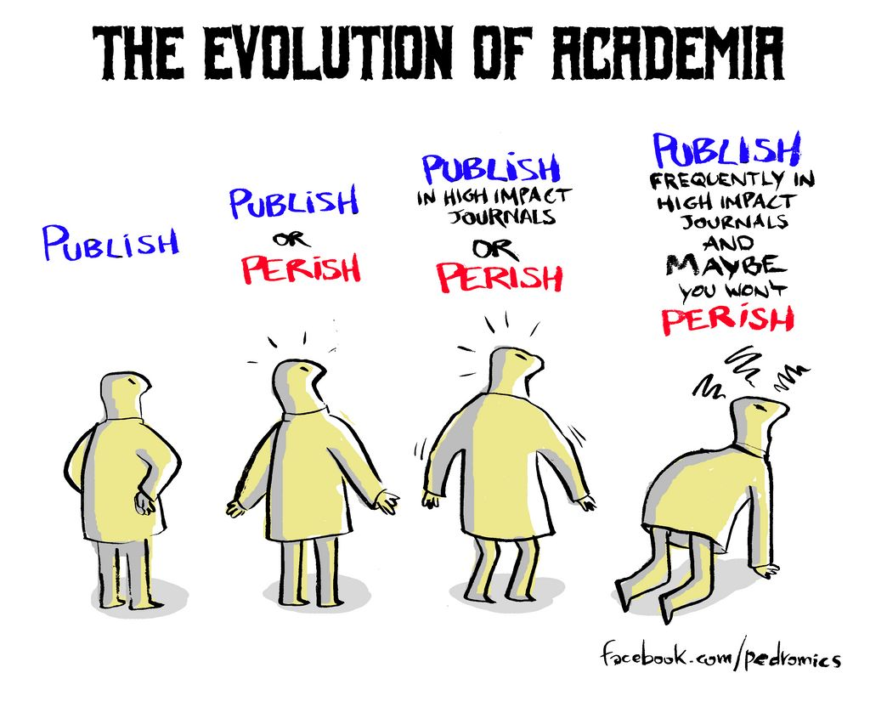
Source: https://walkingscienceshoes.wordpress.com/2020/02/05/publish-or-perish-is-it-that-simple/

Slide 3
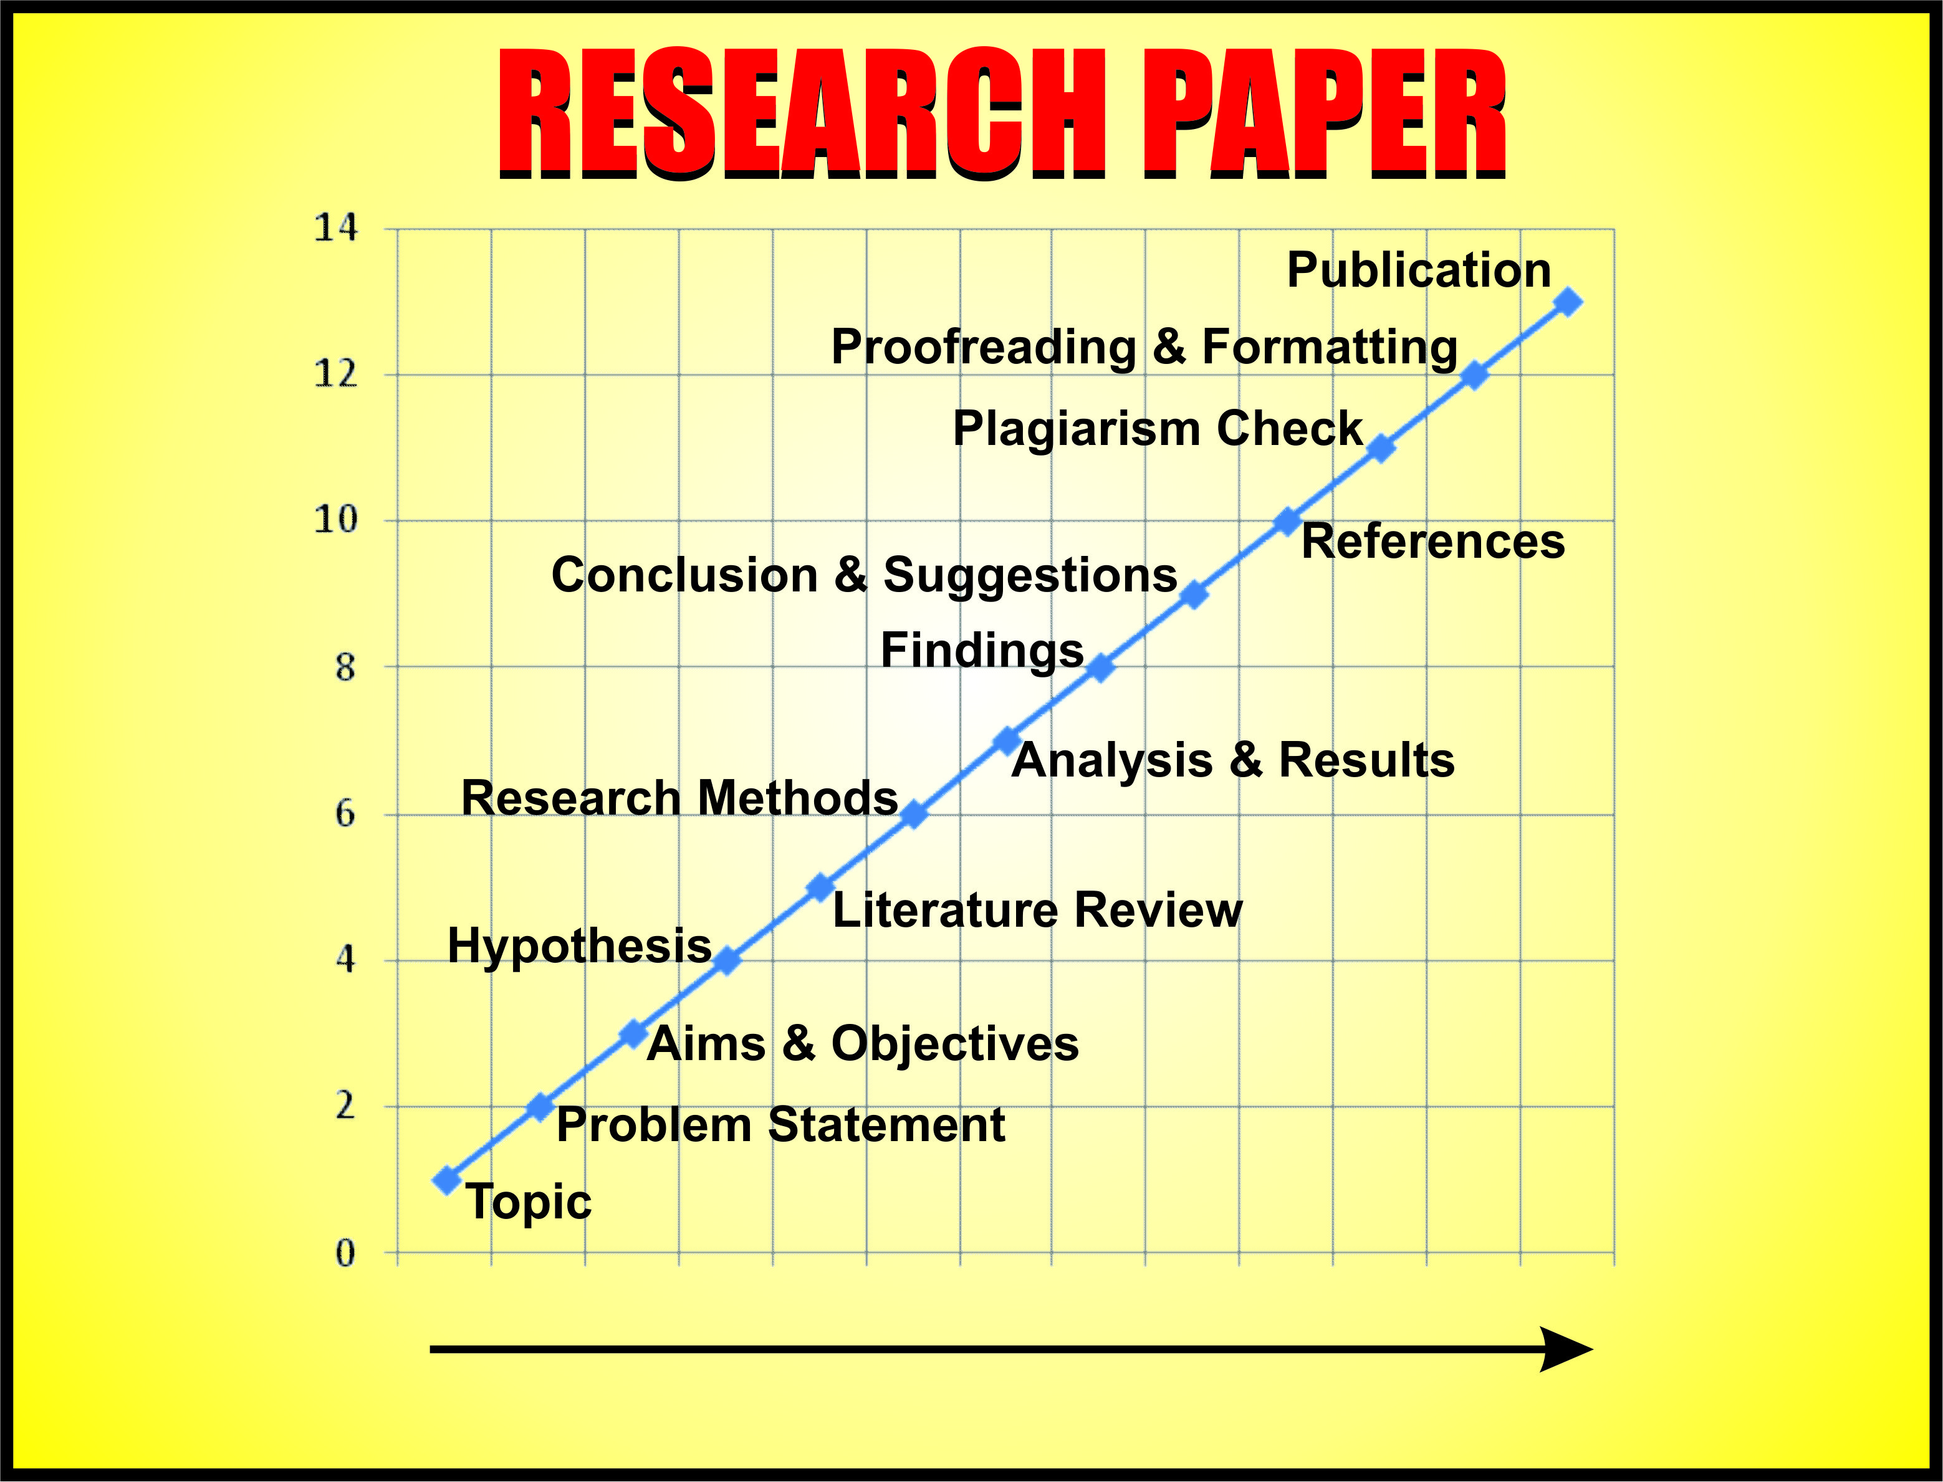

Source: http://www.writekraft.com/research-paper/

Slide 4
Research Publication
Functions of higher education
1. Teaching
2. Research – publications, patents, products, and services
3. Extension services
Research publication is considered a crucial factor for ranking of universities and colleges.
Ranking is linked with admission and placement of students.
It is associated with prestige for the institute and for the nation.
So, research publication in genuine impact factor/ standard/ well-known journals is essential today for accreditation, placement and recognition.
Next impact factor journals

Slide 5
Impact Factor Journals
Journals in which researchers from top universities publish their papers
QS University World Rankings
2016-17
Among top 15
US: 7
UK: 4
Singapore: 2
Switzerland: 1
France: 1
Status of India
IISc -152
IITD - 185
IITB - 219
IITM - 249
1. Massachusetts Institute of Technology (MIT)
2. Stanford University
3. Harvard University
4. University of Cambridge
5. California Institute of Technology (Caltech)
6. University of Oxford
7. University College London
8. Swiss Federal Institute of Technology (ETH)
9. Imperial College London
10. Chicago University
11. Princeton University
12. National University of Singapore
13. Nanyang Technological University
14. Ecole Polytechnique Federale de Lausanne
15. Yale University
Next some research journals

Slide 6
Recognized Journal Publishers
Scopus Indexed Journals
Web of Science Indexed journals
Associations and
Companies
ASME
IEEE
Elsevier
Emerald
Sage
CRC
Wiley
Taylor and Francis
Routledge
Springer
Universities
British
Oxford
Cambridge
American
MIT
Harvard
Stanford
Cornell
Yale
Indian
IISc
IUP University
Next, what is a research paper?

Slide 7
Technical report
Progress
Process
Results
Recommendations and conclusions

Slide 8
Reports | Proposals
contain information about what has happened in the past | examine what may happen in the future
record objective facts | aim mainly to persuade the reader to make a specific decision
to provide information is the main aim | express opinions, albeit supported by objective facts

Slide 9
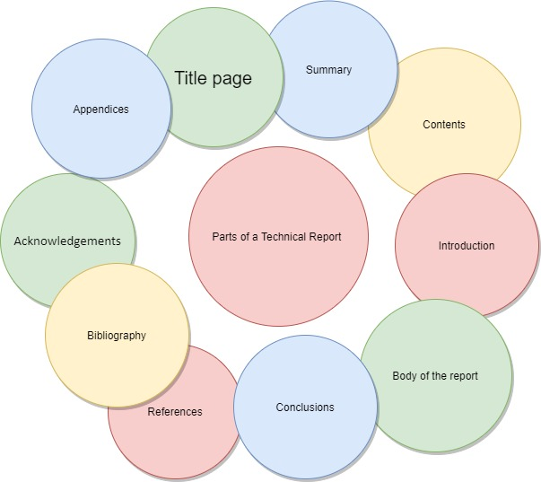
Parts of a Technical Report

Slide 10
Planning the report
Writing the first draft
Revising the first draft
Diagrams, graphs, tables and mathematics
Report layout
Headings
Originality and plagiarism
Finalising the report and proofreading
The Summary
Proofreading

Slide 11
Types of report
Memorandum report
Some reports contain no more than a simple statement recording an event, a visit or some circumstances, with a note of action taken.
Stand alone report
Other reports include detailed explanations of facts, conclusions, and perhaps recommendations for action

Slide 12
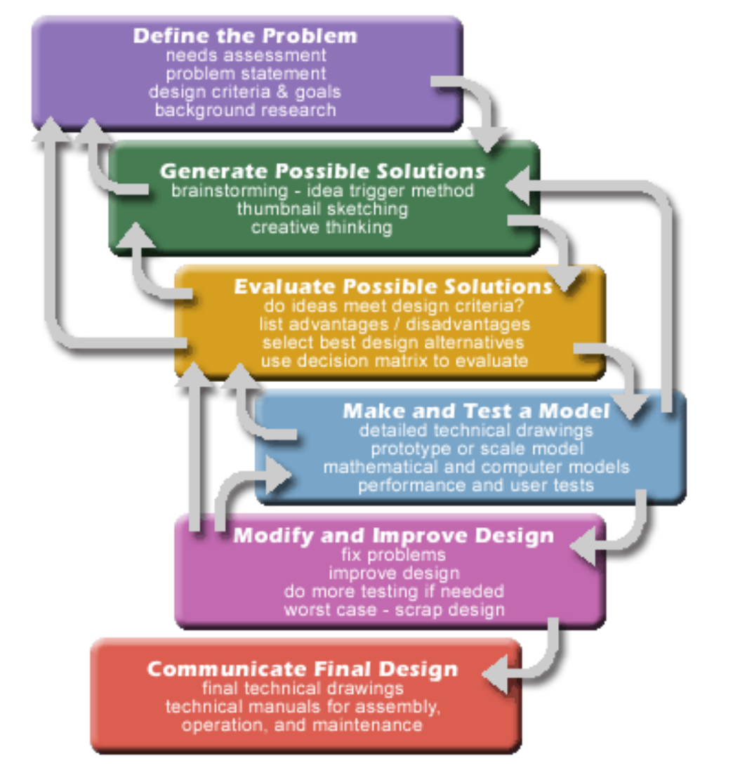

Slide 13
Ask yourself
How does it help the society?
What new?
Is there anything people seem to overlook in the sources you research?
Are there any heated debates you can address?
Do you have a unique take on your topic?
Have there been some recent developments that build on the extant research?
What is the argument?
Search is done………so Re-search!

Slide 14
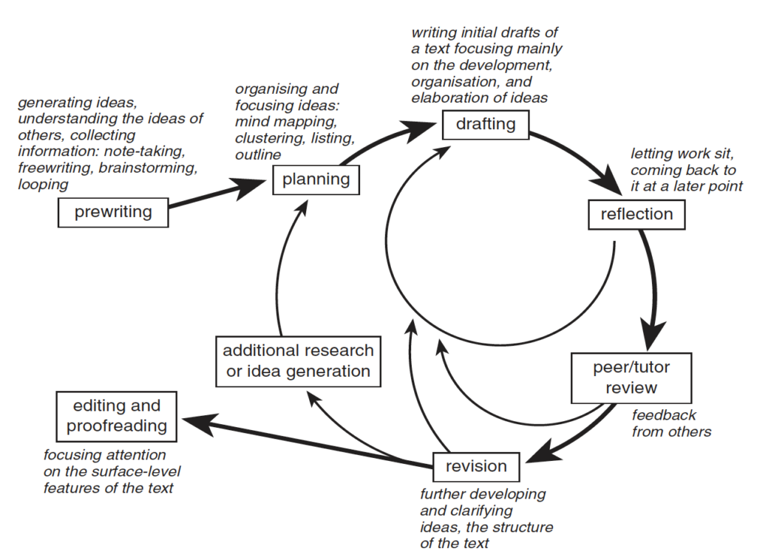

Slide 15
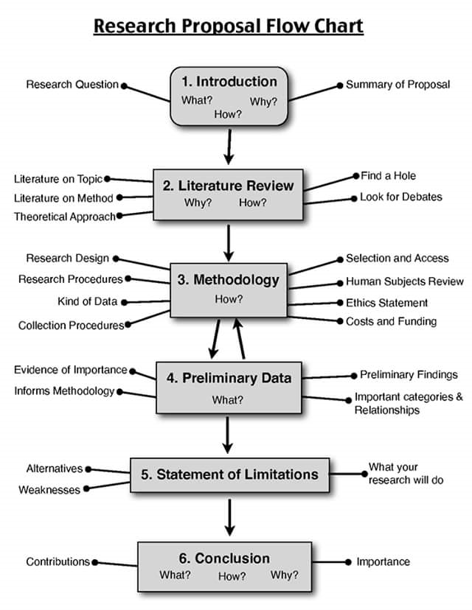

Slide 16
What is a Research Paper?
A well-written document of 10 to 30 pages reporting a theoretical and or experimental research with a focus on answering a research question against the backdrop of a literature review, using appropriate methods and materials, stating the results as well as discussing their significance and providing a conclusion and scope for further research as well appropriate and current references.
Next structure of a research paper

Slide 17
Structure of a Research Paper
Title
Authors and their Affiliation
Abstract
Keywords
Introduction
Literature Review
Methods and Materials
Results and Discussion
Conclusion
References
Next, a good paper

Slide 18
A Good Paper
First, matching the title, abstract, introduction, survey, design, interpretation and conclusion
Next, not exactly repetition but rephrasing with suitable transitions and focus
Title=Abstract=Keywords=Introduction=Conclusion
Length of AIC – almost a paragraph of 100 – 300 words
Read several samples: one is here.
Next Title

Slide 19
Title
Summary of the entire article
Brief and focussed
10 – 12 words
Must capture the abstract and the whole paper exactly
Next sample title

Slide 20

Sample Title
Understanding the attitude of ESL learners to vocabulary learning
Next abstract

Slide 21


Abstract
The abstract is a compulsory component of every research paper.
It may be sent first to editors for creating interest in your work.
It gives a summary of the whole paper with the statement of the problem, method of study, the findings and their significance for future research.
It decides the fate of your contribution/ work.
The length may vary from 100 to 300 words.
Next sample abstract

Slide 22
Sample Abstract
The study investigates the attitudes of learners towards the importance of vocabulary and their choice of sources to learn new words. It chiefly explores the differences in attitudes and choices of learners by a survey which was conducted among 730 first-year engineering students of Anna University, India. The questionnaire had two different divisions, i.e., importance given to vocabulary learning and sources of new words. The sources of new words further had four sub-divisions based on language skills. The data were collected from students and statistically analyzed to answer the research questions of the study. In general, the results show that students consider vocabulary as an important aspect of language learning. Students admit the importance of vocabulary to understand a text. Interestingly, gender influences the choice of sources to learn new words. Further, the medium of education also significantly influences learners’ attitudes and their choices of sources in vocabulary learning.
Next keywords

Slide 23

Keywords
Normally five key words
Discussion
Why do journals insist on key words?
What is SEO?
Next sample keywords

Slide 24

Sample Keywords
English language teaching
English in India
English vocabulary
Vocabulary learning
Sources to learn vocabulary
Learners’ attitude
Learner differences
Next introduction

Slide 25

Introduction
Introduces the subject.
Explains the importance of the study.
Justifies the choice of the problem and the method adopted to understand/ solve the problem.
Provides a general background.
Gives the problem statement and scope of the work.
Outlines the organization of the work.
Next sample introduction

Slide 26
Sample Introduction
Vocabulary learning is the fundamental step in learning a language. It is also a perennial learning aspect of any language (Gifford, 2013). “Vocabulary learning never stops even long after the grammar system is firmly in place” says Thornbury (2002, p. 160). Zimmerman (2009) also described vocabulary learning as a continuous process throughout one’s life. Vocabulary helps to judge a person in interviews, personality tests and even in many competitive exams. Anderson and Freebody (1979) observed a strong correlation between vocabulary test and general intelligence. Gifford (2013, p. 18) mentioned that “a person having more breadth and depth of vocabulary has wider competence to communicate and to understand a communication, and is to be considered intelligent.” In addition, the intensity of competence and fluency in English language knowledge is divergent among the English as second language (ESL) learners in Indian classrooms (Kohli, 2012). Their level ranges from first generation learners to first-class
learners. First generation learners are graduates who attend college for the first time in their family. None of the other family members are graduates. Hence, these learners belong to the first generation to become graduates. In addition, exposure to English language outside the classroom is limited for the first generation learners. In contrast, first class learners hail from educated families and are fluent in English language. Therefore, ESL teachers need to adopt strategies which would help learners to develop their vocabulary. It is necessary to investigate learners’ individual variations to provide them with better language learning opportunities. Thus, knowing ESL learners’ attitude towards the importance of vocabulary learning is crucial. Moreover, the identification of the sources used by students as linguistic inputs to learn new words helps to exploit them for effective vocabulary learning.
Next literature review

Slide 27

Literature Review
Survey of existing literature in the recent past, five or ten years depending on the amount of research in the area – articles, books, reports, opinions, etc.
General area and specific field
Interdisciplinary area is tricky.
Topic is narrowed down but depth is profound.
Survey of surveys
Review articles
And then research articles
Use past tense
Do not copy some other literature review.
Give the context and background clearly
Organize ideas thematically or chronologically
Paraphrase and summarize in your own words
Reorganize ideas to suit your topic.
Next methods and materials

Slide 28
Review of Literature contd
Step 1
Search for relevant literature on your topic-books journals magazines websites etc
Step 2
Evaluate & Select Resources
(Read the abstract also the biblio/references)
Pay attention to the citation number(more the better)
Step 3
Identify themes,debates, and gaps
take notes,rganise and structure

Slide 29
Things to look for
Trends
Themes
Debates or contradictions
Influential studies
Gaps
Step 4
Outline your literature review’s structure
4 approaches to structure literature review
1.Chronological -old to new publications
2.Thematic
3.Methodological
4.theoritical

Slide 30

Methods and Materials
Quantitative
Qualitative
Content analysis
Taguchi method
Finite Element Analysis (FEA)
MATLAB software
SPSS software
Questionnaire survey
Pilot study and Main study
Anova test and ‘t’ test
Regression analysis
Pre-test and post-test
Lab instruments/ machines
Chemical/physical materials
Primary and secondary sources
Next results and discussion

Slide 31

Results and Discussion
Findings
Related to objectives and research questions
1.
2.
3.
Significance of findings in relation to earlier similar findings in approach and also outcome
Significance for the filed, society, humanity, earth and planetary existence
Next conclusion

Slide 32


Conclusion
Brief
Summative
Suggestive
Prospective
Directional
No new ideas
No tables and figures
No irrelevant ideas
Next sample conclusion

Slide 33
Sample Conclusion
This survey study among the students of Anna University in Chennai, India, helps to understand the attitude of ESL students to vocabulary learning. First, the students consider vocabulary as a major factor to comprehend and to express themselves with clarity in spoken communication. It appears that they give slightly less importance to vocabulary in reading and writing. Perhaps, students understand the text without any difficulty even if there are one or two unknown words in the text. Likewise, students may prefer to use known words more than the appropriate words to express their ideas in written communication. Second, students mainly prefer to learn vocabulary from friends and also through the use of mobile phones, laptop, Internet and SMS. This fact
suggests that students’ choice of sources is related to social learning and technology. It also suggests that the students should use other sources for effective vocabulary learning. Third, female students revealed higher use of sources to learn vocabulary than male students. Finally, Tamil medium students give more importance to vocabulary and revealed higher use of sources to learn vocabulary than English medium students. Therefore, the study reveals the impact of gender and medium on students’ attitude to vocabulary learning. On the whole, students realize the importance of vocabulary and the need for sources to learn vocabulary.
Next references

Slide 34

References
Journal articles
Books
Book chapters
Conference Proceedings
Government Reports
Websites
Newspaper articles
Published Interviews
Email communication
American Psychological Association (APA)
Modern Language Association (MLA)
Institution of Electrical and Electronics Engineers (IEEE)
Harvard, Chicago, etc.
Next sample references

Slide 35
Sample References
ANDERSON, R.C.; FREEBODY, P. 1979. Vocabulary knowledge. Reading Education Report, n. 136. Available at: https://www.ideals.illinois.edu/bitstream/handle/ 2142/17498/ ctrstreadeducrepv01979i00011_opt.pdf?sequence=1. Accessed on: 07/08/2014
ANDERSON, R.C.; NAGY, W.E. 1991. Word meanings. In: R. BARR; M.L. KAMIL; P. MOSENTHAL; P.D. PEARSON (eds.), Handbook of reading research. Vol. 2, New York, Longman, p. 690-724.
COOK, V. 1991. Second language learning and language teaching. London, Hodder & Steughton, 306 p.
CURTIS, M.E. 2006. The role of vocabulary instruction in adult basic education. In: J.P. COMINGS; B. GARNER; C. SMITH (eds.), Review of adult learning and literacy. Vol. 6, New Jersey, Lawrence Erlbaum Associates, p. 43-69
DHANAVEL, S. P. 2012. English language teaching in India: the shifting paradigms. New Delhi, India, Tata McGraw-Hill Ltd., 137 p.
EVANS, S.; MORRISON, B. 2011. Meeting the challenges of English-medium higher education: The first-year experience in Hong Kong. English for Specific Purposes, 30(3):198-208. http://dx.doi.org/10.1016/j.esp.2011.01.001
FRANCIS, R. 2012. Animated education for vocabulary building. In: A.L. KHANNA; A.S. GUPTA (eds.), Essential readings for teachers of English: from research insights to classroom practices. New Delhi, Orient BlackSwan, p. 303-314.
GIFFORD, F. 2013. How to enrich your vocabulary? New Delhi, Cyber Tech Publications, 256 p.
https://pressbooks.bccampus.ca/technicalwriting/chapter/writing-processes/
Next acknowledgement

Slide 36

Acknowledgement
Papers from funded projects must acknowledge the financial assistance of the funding agency.
Personal acknowledgements to individuals for their help can also be made, if desired.
DRDO, DST, DBT, FIST, CSIR, ICAR, ICMR, UGC, ICSSR, ICPR, University/ Institute fellowships, Companies, Foundations, International agencies, etc.
Next sample acknowledgement

Slide 37
Sample Acknowledgement
Dr C Naik EFLU Hyderabad for a two-year Research Fellowship for my PhD.
Source:
Vairavan C., and Dhanavel S P. "Power, Position and Agony in Harold Pinter's One for the Road," The IUP Journal of English Studies, Vol.9, No.3, (September, 2014), pp. 37-47.
Next interpreting tables and figures

Slide 38
Interpreting Tables and Figures
Tables and figures communicate ideas graphically quickly and easily.
The number of tables and figures is restricted by journals.
Three to five tables and figures may be good enough for a paper of 10 to 15 pages.
More importantly, interpreting the data in them is crucial.
It is a difficult terrain, but one has to do it.
Scholars appear to be verbally challenged today.
Next sample table

Slide 39
Sample Table
Table 1. Frequency distribution of gender and medium of school education
Gender | Frequency | Percent
Male | 453 | 62.1
Female | 277 | 37.9
Total | 730 | 100.0
Age | Frequency | Percent
17 | 232 | 31.8
18 | 473 | 64.8
19 | 25 | 3.4
Total | 730 | 100.0
Medium of school education | Frequency | Percent
English | 614 | 84.1
Tamil | 116 | 15.9
Total | 730 | 100.0
Let us try interpreting the table.
Next sample interpretation

Slide 40
Sample Table Interpretation
The basic descriptive analysis in Table 1 provides the demographic details collected from the participants. First, out of the 730 samples, 453 (62.1%) were male and 277 (37.9%) were female participants. Second, there were 232 (31.8%) participants in the age of 17 years, 473 (64.8%) participants in 18 years, and 25 (3.4%) participants in 19 years. Third, there were 614 (84.1%) students from English medium and 116 (15.9%) students from Tamil medium. The students from Tamil medium schools learnt all the subjects in Tamil language except the English language course. As a consequence, they had limited exposure to English language in their schools. Next, the descriptive analysis focuses on the responses of the students.

Slide 41
Original Draft
TIME DELAY AND COST OVERRUN OF ROB CONSTRUCTION PROJECTS IN INDIA
ABSTRACT
Road Over Bridges (ROB’s) are key infrastructure facilities in India. Construction of ROB’s in India is prone to time delay and cost overrun due to various reasons. This paper aims at studying the factors that contribute to time delay and cost overrun of ROB construction projects in India. From literature survey, 29 causes were identified as causing time delay and cost overrun of infrastructure projects. Data for the research study were collected from owners, consultants and contractors of ROB projects for twenty nine identified factors through questionnaire survey. Ranking of foremost factors was done from the frequency of occurrences. The correlation between owners, consultants and contractors on ranking of factors was arrived by spearmen rank correlation. Factor analysis was used to reduce the factors to groups and identify the key groups responsible for time delay and cost overrun of ROB construction projects in India. This study will help the stakeholders on ROB’s to understand the factors and significant groups influencing the time and cost overrun and propose corrective action in ROB’s construction in India.
KEY WORDS
Time delay, cost overrun, road over bridges, land acquisition, project

Slide 42
Revised Draft
Time Delay and Cost Overrun of ROB Construction Projects in India
Abstract
This paper aims at studying the factors that contribute to time delay and cost overrun of Road Over Bridge (ROB) projects in India. Data for the research study were collected from 62 respondents, including owners, contractors and consultants of ROB projects. The literature survey and the questionnaire survey helped in identifying 29 factors. The topmost factors were ranked based on the frequency of occurrences. The correlation among owners, contractors and consultants on ranking of factors was derived by Spearman rank correlation. Factor analysis was used to classify the factors into groups and identify the key groups responsible for time delay and cost overrun of projects. This study will help all stakeholders of ROB projects in India to understand the factors and thereby reduce time delay and cost overrun as well as expedite their completion.
Keywords:
Time delay, cost overrun, road over bridges, land acquisition, infrastructure projects

Slide 43

Thank you very much

Slide 44
rashmirekha.borah@vit.ac.in

